Slide 1
professional
Development in
Early childhood education
Grand canyon university: ece 501
Jessica sanchez
September 9, 2020
Notes:
Professional development is crucial for early childhood educators. Participating in workshops, continuing education courses, and conferences allow educators to learn new knowledge, skills, and strategies to implement in the classroom to improve their student's overall learning and development.

Slide 2

overview
How PD maximizes learning outcomes
What makes PD effective?
NAEYC professional standards
Promoting professional practice
Current PD opportunities
Stock Image, Microsoft Office
Notes:
This presentation will discuss how early childhood professional development maximizes student's learning outcomes, what strategies make professional development opportunities effective, how the NAEYC professional standards inform early childhood education, important principles that promote professional practice, and a list of current professional development opportunities.

Slide 3

How PD maximizes learning outcomes
"Teachers who receive substantial professional development can boost their students’ achievement by about 21 percentile points" (Yoon, 2007, p. iii).
Stock Image, Microsoft Office
Notes:
In his report "Reviewing Evidence on How Teacher Professional Development Affects Student Achievement" Yoon posits that, "Professional development for teachers is a key mechanism for improving classroom instruction and student achievement" (Yoon, 2007, p. 1). It is important for educators to continually learn new skills and knowledge in order to best serve their students. Participating in professional development is also one way of modeling the concept of lifelong learning to our students. The most important aspect of professional development is the positive impact it has on students. Yoon states, "Teachers who receive substantial professional development can boost their students' achievement by about 21 percentile points" (Yoon, 2007, p. iii).

Slide 4

What makes pd effective?
PD is most effective when:
  Specific goals are set
Stock Image, Microsoft Office
Notes:
Klute states that, "professional development efforts may be more effective when they are focused on specific and articulated objectives rather than more open ended" (Klute, 2013, p. 64). When searching for a professional development opportunity, it is crucial to self-assess and choose topics of interest that will strengthen your teaching practices and help you overcome the challenges you are facing in the classroom.

Slide 5

What makes pd effective?
PD is most effective when it:
  Focuses on practice
Stock Image, Microsoft Office
Notes:
Klute also notes that, "professional development efforts are more effective when they also include a focus on the application of knowledge, or practice" (Klute, 2013, p. 64). In order to get the most out of a professional development opportunity, make sure the curriculum provides exercises for educators to apply the content they have learned. This will help you return to the classroom with the confidence you need to apply the new knowledge in the context of your own teaching.

Slide 6

What makes pd effective?
PD is most effective when there is:
  Collective participation
Stock Image, Microsoft Office
Notes:
Klute argues that, "professional development is more effective when it is delivered to whole programs or classroom teams" (Klute, 2013, p. 65). In this case, it is important for all educators in a school community to be on the same page. When preparing to attend a professional development opportunity, try to include as many educators from your school community as possible. That way when you return to the classroom with new knowledge, you will have a team of allies to support and encourage you.

Slide 7

What makes pd effective?
PD is most effective when the:
  Intensity and duration match content
Stock Image, Microsoft Office
Notes:
Klute explains that, "discrete skills can be successfully addressed with short-term professional development efforts" but, "more complex, global changes need more sustained professional development interventions" (Klute, 2013, p. 66). This means that it is important for you to assess the content of a workshop or course to make sure that it allows an appropriate amount of time to understand and apply the content.

Slide 8

NAEYC professional standards
1. Promoting child development and learning
Stock Image, Microsoft Office
Notes:
The NAEYC's "2010 Standards for Initial Early Childhood Professional Preparation" provides key concepts for early childhood educators to master, so that all young children receive the highest quality educational experiences. The first standard, "Promoting child development and learning," explains that early childhood educators should have a thorough understanding of child development (NAEYC, 2010, p. 1). When choosing a professional development opportunity, it is important that the workshop or course includes information about child development and learning.

Slide 9

themes from NAEYC professional standards
2. Building family and community relationships
Pbs.org
Notes:
The second standard "Building family and community relationships," explains that early childhood educators should understand the importance of creating meaningful partnerships with families and the community (NAEYC, 2010, p. 1). When choosing a professional development opportunity, keep in mind that learning more about how to form meaningful partnerships with families and communities is crucial to successful early childhood environments.

Slide 10
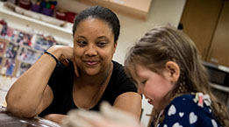
themes from NAEYC professional standards
3. Observing, documenting, and assessing
bankstreet.edu
Notes:
The third standard, "Observing, documenting, and assessing," explains that educators should have a comprehensive understanding of the best strategies and procedures to observe, document, and assess young children (NAEYC, 2010, p. 1). Professional development opportunities that provide more information and strategies on developmentally appropriate assessment will allow educators to stay informed on the most up-to-date procedures and practices.

Slide 11
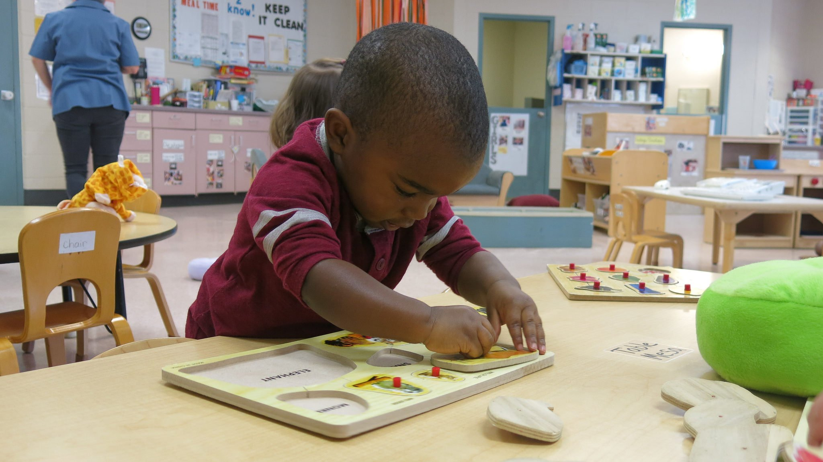
themes from NAEYC professional standards
4. Using developmentally effective approaches
Partnershipsforearlylearning.org
Notes:
The fourth standard, "Using developmentally effective approaches," explains that early childhood educators should understand that creating meaningful, trusting relationships with young children is key to a child's successful learning and growth in the classroom (NAEYC, 2010, p. 1). Professional development opportunities that provide skills and strategies for developing positive relationships with young children are an important part of lifelong learning for early childhood educators.

Slide 12

themes from NAEYC professional standards
5. Using content knowledge to build curriculum
Stock Image, Microsoft Office
Notes:
The fifth standard, "Using content knowledge to build curriculum," explains that designing a challenging curriculum for young children is based on understanding content knowledge in the following areas: language and literacy, the arts, mathematics, science, physical activity and education, health and safety, and social studies (NAEYC, 2010, p. 2). Professional development opportunities that provide knowledge on any of these key areas allows educators to learn more, which in turn provides their students with a wider range of knowledge in these areas.

Slide 13

themes from NAEYC professional standards
6. Becoming a professional
funderstanding.com
Notes:
The sixth standard, "Becoming a professional," explains that early childhood educators should follow ethical guidelines, practice lifelong learning, reflect on their own teaching, make informed decisions, and advocate for fair educational experiences for all children (NAEYC, 2010, p. 2). This means that participating in professional development opportunities is an integral part of being an early childhood educator.

Slide 14
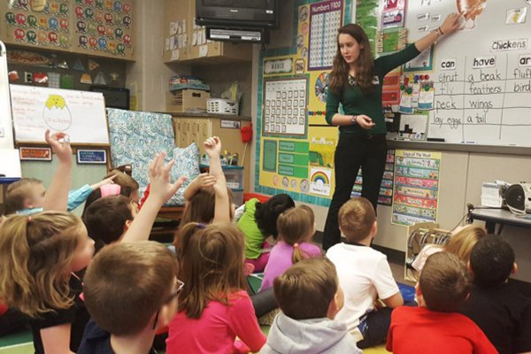
themes from NAEYC professional standards
7. Early childhood field experiences
ycp.edu
Notes:
The seventh and final standard, "Early childhood field experiences," explains the importance of having experience observing and teaching young children, including a variety of age groups (birth-3, 3-5, 5-8) as well as a variety of settings (schools, child care centers, homes, etc) (NAEYC, 2010, p.2). This is a key component of an early childhood educators initial professional development program.

Slide 15

promoting professional practice
Ethical Responsibilities to Children (NAEYC, 2011)
Stock Image, Microsoft Office
Notes:
The NAEYC published the "Code of Ethical Conduct and Statement of Commitment," which provides guidelines for early childhood educators' responsibilities to the following groups: children, families, colleagues, and community and society. The first group described in the code is children. As early childhood educators, we have a responsibility to "provide care and education in settings that are safe, healthy, nurturing, and responsive for each child (NAEYC, 2011, p. 2). This means that our commitment to lifelong learning and professional development should, at its core, demonstrate our commitment to educating young children.

Slide 16

promoting professional practice
Ethical Responsibilities to Families (NAEYC, 2011)
Tipsonlifeandlove.org
Notes:
The second group described in the code is families. As early childhood educators, we have a "responsibility to bring about communication, cooperation, and collaboration between the home and early childhood program in ways that enhance the child's development" (NAEYC, 2011, p. 3). This means that as we seek out professional development opportunities, we should search for the knowledge and skills needed to create meaningful partnerships with families.

Slide 17
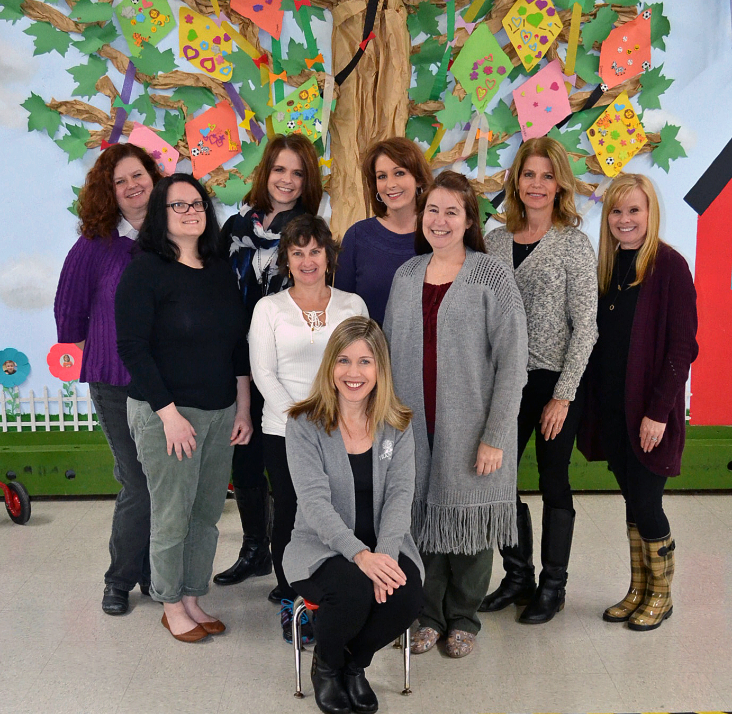
promoting professional practice
Ethical Responsibilities to Colleagues (NAEYC, 2011)
frankfortparks.org
Notes:
The third group described in the code is colleagues. According to the code, as educators, "our primary responsibility to colleagues is to establish and maintain settings and relationships that support productive work and meet professional needs" (NAEYC, 2011, p. 5). This means that in order to provide a safe and nurturing environment for young children, we must be caring and cooperative towards our colleagues. We should seek professional development opportunities that can enhance our knowledge and skills in creating professional, positive relationships with our colleagues.

Slide 18

promoting professional practice
Ethical Responsibilities to Community and Society (NAEYC, 2011)
Realtor.com
Notes:
The fourth group described in the code is community and society. As educators, we have a responsibility to the community to "provide programs that meet the diverse needs of families, to cooperate with agencies and professions that share the responsibility for children, to assist families in gaining access to those agencies and allied professionals, and to assist in the development of community programs that are needed but not currently available" (NAEYC, 2011, p. 6). This means that we should seek professional development opportunities that provide the knowledge and skills needed to collaborate with community organizations and other allied professionals within society in order to best serve young children.

Slide 19

promoting professional practice
Statement of Commitment (NAEYC, 2011)
Firstrepublic.com
Notes:
Lastly, the code provides a "Statement of Commitment," that summarizes all of the ideals and principles described in the code (NAEYC, 2011, p. 9). This statement is provided, so that each individual educator can fully understand their responsibilities to the profession of early childhood education. In order to uphold all of the ideals and principles described in the code we must, as individuals, be willing to embody them ourselves and reflect on our own personal behaviors and attitudes in order to fulfill our calling as educators.

Slide 20

professional development opportunities
GCU Continuing Education Courses
  COA-5300TE: Signs of Physical, Emotional, Sexual Abuse, Neglect, and Bullying (9/17/20)
Notes:
In closing, I have provided the following current professional development opportunities that align with the themes and concepts discussed in this presentation. The first is a continuing education course at Grand Canyon University titled "Signs of Physical, Emotional, Sexual Abuse, Neglect, and Bullying" (GCU, 2020). This course focuses on "identifying and responding to signs of child abuse and bullying" (GCU, 2020).

Slide 21

professional development opportunities
NAEYC Professional Development
  Webinar: Families and Educators Supporting Learning at Home (Recorded)
Notes:
The second professional development opportunity is a recorded webinar from the NAEYC titled "Families and Educators Supporting Learning at Home" (NAEYC, 2020). This webinar recognizes that during this difficult time of global health crisis, it is crucial for early childhood educators to adapt to supporting families at home.

Slide 22

professional development opportunities
California Teachers Association
  Conference: Region II Virtual Leadership Conference (9/30/2020)
Notes:
The third professional development opportunity is a conference created by the California Teachers Association titled "Region II Virual Leadership Conference." This conference provides "keynote speakers, over 40 elective sessions, exhibitor showcase, and much more" (CTA, 2020). This is an opportunity not only to gain knowledge and skills, but to meet other educators from throughout California.

Slide 23

professional development opportunities
Brandman University
  Online Class: Introduction to Project Based Learning Experiences
Notes:
The fourth professional development opportunity is an online continuing education course titled "Introduction to Project Based Learning Experiences" (Brandman, 2020). This course focuses on creating a project based learning curriculum that "connects academic skills with real world learning" (Brandman, 2020).

Slide 24
references
Brandman University. 2020. Introduction to Project Based Learning Experiences. Retrieved September 7, 2020, from https://www.brandman.edu/academic-programs/extended-education/introduction-to-project-based-learning-experiences
California Teachers Association. (2020). Professional Development. Retrieved September 7, 2020, from https://www.cta.org/for-educators/professional-development
Grand Canyon University. (2020). Continuing Education Courses. Retrieved September 5, 2020, from https://www.gcu.edu/individual-courses/continuing-education
Klute, M. (2013). Connecting Research to Practice: Viewing Data Utilization Through the Lens of Professional Development. Early Education & Development, 24(1), 63–67. https://doi-org.lopes.idm.oclc.org/10.1080/10409289.2013.736129

Slide 25
References (continued)
National Association for the Education of Young Children. (2020). Professional Development. Retrieved September 7, 2020, from https://www.naeyc.org/resources/pd
National Association for the Education of Young Children. (2010). 2010 Standards for Initial Early Childhood Professional Preparation. https://www.naeyc.org/sites/default/files/globally-shared/downloads/PDFs/our-work/higher-ed/NAEYC-Initial-Professional-Preparation-Standards-Summary.pdf
National Association for the Education of Young Children. (2011). Code of Ethical Conduct and Statement of Commitment. Retrieved September 5, 2020 from https://www.naeyc.org/resources/position-statements/ethical-conduct
Yoon, K. S., Duncan, T., Lee, S. W.-Y., Scarloss, B., & Shapley, K. L. (2007). Reviewing the Evidence on How Teacher Professional Development Affects Student Achievement. Issues & Answers. REL 2007-No. 033. In Regional Educational Laboratory Southwest. Regional Educational Laboratory Southwest.

