Slide 1
The Child assessment cycle
Jessica Sanchez
GCU - ECE 520
December 16, 2020
Notes:
Good afternoon, colleagues. Thank you for joining me for our monthly professional development. Today, I am going to talk about the child assessment cycle.

Slide 2
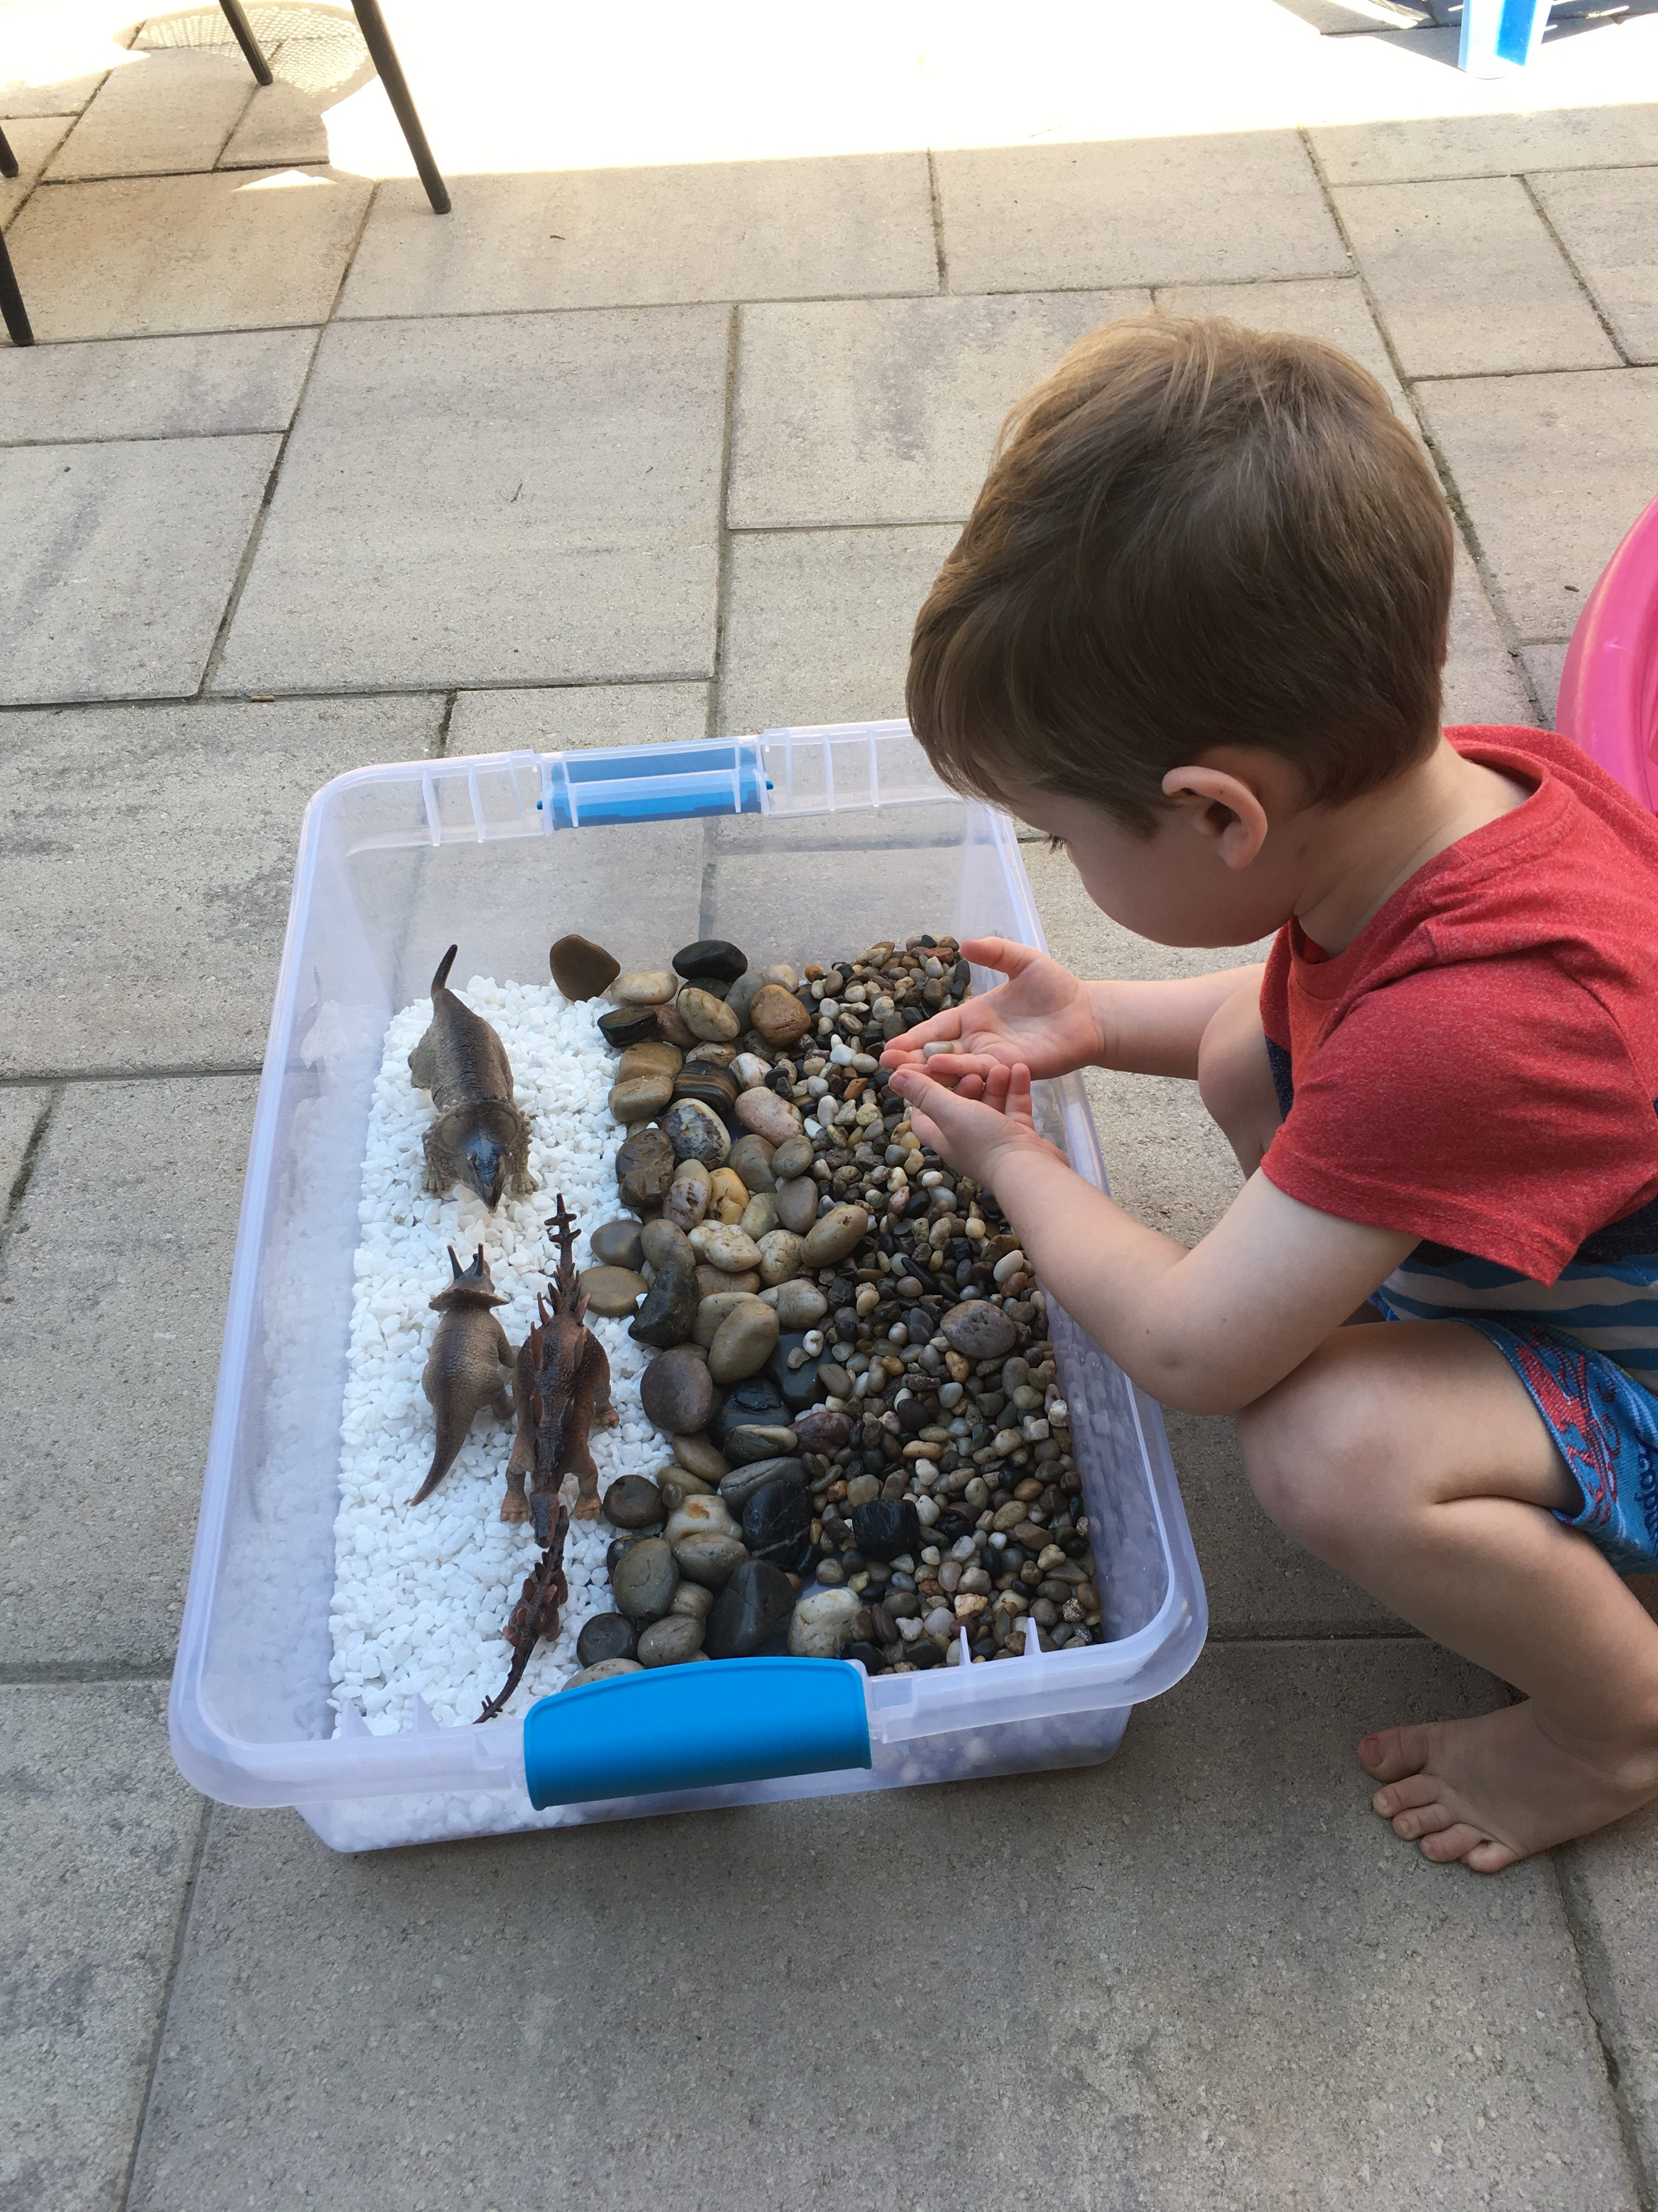
Overview
Purpose of Assessment
Pre-Assessment & Post-Assessment
Purpose Leads to Informative Data
Stages of Assessment Cycle
Sample Assessment Scenario
Teacher Responsibilities
Resources
Photo by OurDailyMess.com
Notes:
In this session, we will talk about the purpose of assessing young children, what to do before and after assessment, why a clear purpose for assessment leads to more informative data, and the stages of the assessment cycle. Then I will provide a sample assessment scenario and explain the teacher responsibilities related to such a scenario. Finally, I will provide a list of resources where you can learn more about assessing young children and how to use the data to inform instruction.

Slide 3

Purpose of Assessment
Monitoring a child’s development
Guide classroom planning
Identify children with special needs
Communicate with stakeholders
Photo by KinderCare.com
Notes:
There are a plethora of purposes for assessing a young child. First, assessment allows educators to monitor children’s overall development and focus on areas where they need more support. Secondly, assessment allows educators to plan instruction effectively and intentionally to provide the best experiences and environment for young children to learn. Additionally, assessment allows educators to identify children who may need special interventions or provide evidence to recommend that a child to be evaluated for special needs services and supports. And lastly, assessment provides educators with the information they need to communicate effectively with colleagues, administrators, and parents and caregivers (McAfee, 2016).

Slide 4

Pre- and Post-Assessment
Pre-Assessment:
Why?
What?
When?
How?
Post-Assessment:
Summarize
Analyze
Plan
Photo by Teacher Vision
Notes:
Before assessment begins, educators must ask themselves a series of questions including: “Why is assessment being done? What will be assessed? When?” (McAfee, 2016, p. 32). Educators will also have to decide how to collect and document information. All of these decisions need to be made before assessment can begin, so that assessment is effective and the results are accurate and relevant. After you have collected assessment data, you will then summarize, analyze, and use it to plan your instruction and communicate with stakeholders.

Slide 5

Purpose Leads to Informative Data
Assessment tool
Time
Place
Procedures
Photo by ProdigyGame.com
Notes:
The “Why” question of pre-assessment reveals the true purpose of your assessment. According to McAfee et al., in Assessing and Guiding Young Children’s Development and Learning, “The intended use of an assessment – its purpose – determines every other aspect of how the assessment is conducted” (McAfee, 2016, p. 33). Identifying the purpose of your assessment allows you to determine the correct assessment tool, the appropriate time and place for assessment, and the most effective assessment procedures. Taking the time to set up your assessment well allows you to obtain to most accurate and relevant data. In doing so, you are able to use that data to effectively inform your instruction.

Slide 6
Stages of Assessment Cycle
Observe
Document
Summarize
Analyze
Plan
Communicate
Notes:
Let’s start by looking at the stages of the assessment cycle. Assessment includes observation, documentation, summary, analysis, planning, and communication (Resources for Early Learning, 2014, p. 1). Now that we have a first look at the cycle, let’s delve deeper into each step of the process.

Slide 7
Observation & Documentation
Observe
Document
Summarize
Analyze
Plan
Communicate
Create a system to organize data
Separate observation from teaching
Separate objective from subjective information
Create a shorthand
Notes:
Observation and Documentation are the first two steps in the assessment process. These go hand-in-hand, because in order for observation to count as assessment, it needs to be documented. Before you begin assessment, it is crucial to create a system to organize the data you will collect (Bell, 2017, p. 7-8). Every teacher has their own personal way of organizing information, so this is up to you. Some examples are a filing system with a folder for each child, a binder with dividers for each child, student or classroom tracking sheets, sticky notes, index cards held together with a ring, and many more. It is up to you how you decide to organize your assessment data, but it is important to create a system before you start collecting data. Secondly, it is important to remember that assessment is separate from teaching, which means that you will have to schedule time throughout the day to observe your students that is separate from your teaching (Bell, 2017, p. 7-8). For example, this observation for assessment could occur during free play, recess, meals, and while students are working on a group project. Another important distinction to make when assessing students is to separate objective information from subjective information (Bell, 2017, p. 7-8). When you are assessing a student, you are only documenting the facts of what skills and activities you see a student engaging in, not what you feel about a student’s skills or the activity itself. This is a key component to obtaining accurate and relevant information for assessment. Since you will have limited time and many students to assess, it is recommended that you create a shorthand, so that you can write important milestones or skills down quickly and come back to them when you have time to write a more detailed account (Bell, 2017, p. 7-8).

Slide 8
Summarize & Analyze
Observe
Document
Summarize
Analyze
Plan
Communicate
Summarize:
Reflect
Review
Revise
Analyze:
Hypothesize
Compare & Contrast
Notes:
The next two steps in the assessment process are to summarize and analyze the data your have documented. Similar to observation and documentation, summary and analysis go hand-in-hand. Summarizing the data you have collected allows you to reflect on the student, the class as a whole, any challenges your are facing in the classroom, and what could be modified in order to support your students’ development (McAfee, 2016). Summarizing also allows you to review each area of development to ensure that you are aware of all aspects of a student’s development and nothing is missed or forgotten. It is helpful to have pertinent information about developmental milestones nearby, which leads directly into analysis. In order to analyze your data, you can hypothesize about what the data could reveal about the student, class, and curriculum in general. Next you can compare and contrast the skills your student has exhibited with the developmental milestones that align with their developmental age. This will help you to see what skills haven’t been mastered yet and think of ways to modify your curriculum in order to support those emerging skills. This will also allow you to gather clear evidence of the learning that has occurred in order to share this information with colleagues, administrators, and parents and caregivers.

Slide 9
Plan & Communicate
Observe
Document
Summarize
Analyze
Plan
Communicate
Plan:
Outline
Post
Research
Communicate:
Provides evidence of learning
Provides a pathway
Notes:
After you have summarized and analyzed your student’s assessment data, it is time to put that data to work. Using data to inform instruction is a complex process that requires thoughtfulness, planning, and creativity and therefore will be different for every teacher. In order to use data to plan effectively, it is helpful to document your ideas and outline your plans for implementation (McAfee, 2016). You can even post physical reminders around the classroom that encourage you and other adults to engage in conversations or activities that target a specific developmental area based on your assessment data. It is also helpful to read current research regarding areas of development that need attention in your classroom based on your assessment data. Professional development and learning new strategies to support children’s growth helps you plan and implement instruction more effectively. Finally, communicating assessment results to colleagues, administrators, and parents and caregivers not only provides evidence of learning, but also provides a pathway to deeper conversations about your students with the people who interact with them most. It can often be exciting to provide parents and caregivers with information about how their child is growing and learning in new and exciting ways.

Slide 10
Sample Assessment Scenario
Age of Child
Purpose
Tool
24 months
To monitor child’s gross motor development
Checklist of developmentally appropriate gross motor skills
Notes:
Here is a sample assessment scenario. You have a child in your classroom who is 24 months old. You need to monitor his gross motor development on a regular basis. You have chosen a checklist of developmentally appropriate gross motor skills as your assessment tool.

Slide 11
Teacher Responsibilities
Observe
Document
Analyze
Summarize
Plan
Communicate
observe the child on the playground
Check off all skills you observe the child exhibit
What skills has the child mastered? What skills are still emerging?
Write a summary of overall gross motor development
How can you set up activities that will help the child master emerging skills?
Share your observations with other staff and parents/caregivers
Notes:
Here is a list of teacher responsibilities based on the sample scenario. First, you will need to observe for assessment in an authentic environment, so you choose to observe this child on the playground during free play. You have your checklist with you during observation, so that you can easily check off all the skills you observe this child exhibit while playing on the playground. During nap time, you sit down and write a summary of your observations. Then you ask yourself relevant questions, such as, “What skills has this child mastered? What skills are still emerging?” Then you brainstorm some ideas about how you can support this child’s gross motor development. During pick-up, you mention to this child’s caregiver what you have observed and may even provide photos of this child on the playground or a list of all the skills they have accomplished so far this month. In providing this sample scenario, you can see how the assessment process can be embedded into your daily routine as a teacher.

Slide 12
Resources
Buchanan, M. (2016). 4 Ways Student Data Can Inform Instruction. Retrieved from, https://www.pearsonassessments.com/professional-assessments/blog-webinars/blog/2016/09/4-ways-student-data-can-inform-instruction0.html
Great Schools Partnership. (n.d.) Using Data to Inform Instruction. Retrieved from, https://www.greatschoolspartnership.org/resources/data/using-data-to-inform-instruction/
US Dept. of Ed. (2011). Teachers’ Ability to Use Data to Inform Instruction: Challenges and Supports. Retrieved from, www2.ed.gov/rschstat/eval/data-to-inform-instruction/report.pdf
Zweig, J., et. al. (2015). Data Collection and Use in Early Childhood Education Programs: Evidence from the Northeast Region. Retrieved from, https://files.eric.ed.gov/fulltext/ED555737.pdf
Notes:
Here, I have provided links to more information on how you can use assessment data to inform your instruction. If you would like more information, please contact me and I can easily share these resources with you via email. Thank you for following along during the session and I hope to collaborate with you to provide the best assessment practices to support all of our student’s learning and development.

Slide 13
References
Bell, Douglas D. (2017). Watching the Babies: The Why, What, and How of Observation as Assessment in Infant and Toddler Care. Retrieved from, https://lopes.idm.oclc.org/login?url=http://search.ebscohost.com/login.aspx?direct=true&db=edsbl&AN=RN612174049&site=eds-live&scope=site
McAfee, O., Leong, D., Bodrova, E. (2016). Assessing and guiding young children’s development and learning. Pearson. http://www.gcumedia.com/digital-resources/pearson/2015/assessing-and-guiding-young-childrens-development-and-learning_6e.php
Resources for Early Learning. (2014). Early Childhood Assessment: Resources for Early Learning. Retrieved from, http://resourcesforearlylearning.org/fm/early-childhood-assessment/
Our Daily Mess. (2018). The Perfect Daily and Weekly 2-4 Year Old Schedule [Photo]. Retrieved from, https://ourdailymess.com/2018/10/03/the-perfect-daily-and-weekly-2-4-year-old-schedule/
Kinder Care. (n.d.) Let’s Talk! How to Have Positive Conversations with Teachers When Problems Pop Up [Photo]. Retrieved from, https://www.kindercare.com/content-hub/articles/2016/september/lets-talk-how-to-have-positive-conversations-with-teachers-when-problems-pop-up
Teacher Vision. (2019). 7 Questions to Ask Yourself While Planning Instruction [Photo]. Retrieved from, https://www.teachervision.com/blog/morning-announcements/seven-questions-while-planning-instruction

